Slide 1
Threat modeling global catastrophic risks
Luke Donoho, m.s
@Scronkfinkle

Slide 2
OH MY GOD WE’RE ALL GOING TO F*!&@#^$%ING DIE
Luke Donoho, m.s.

Slide 3
Agenda
Existential Risk
Threat Modeling
Artificial Intelligence
Nanotechnology
Threat Modeling Existential Risk
Closing Thoughts

Slide 4
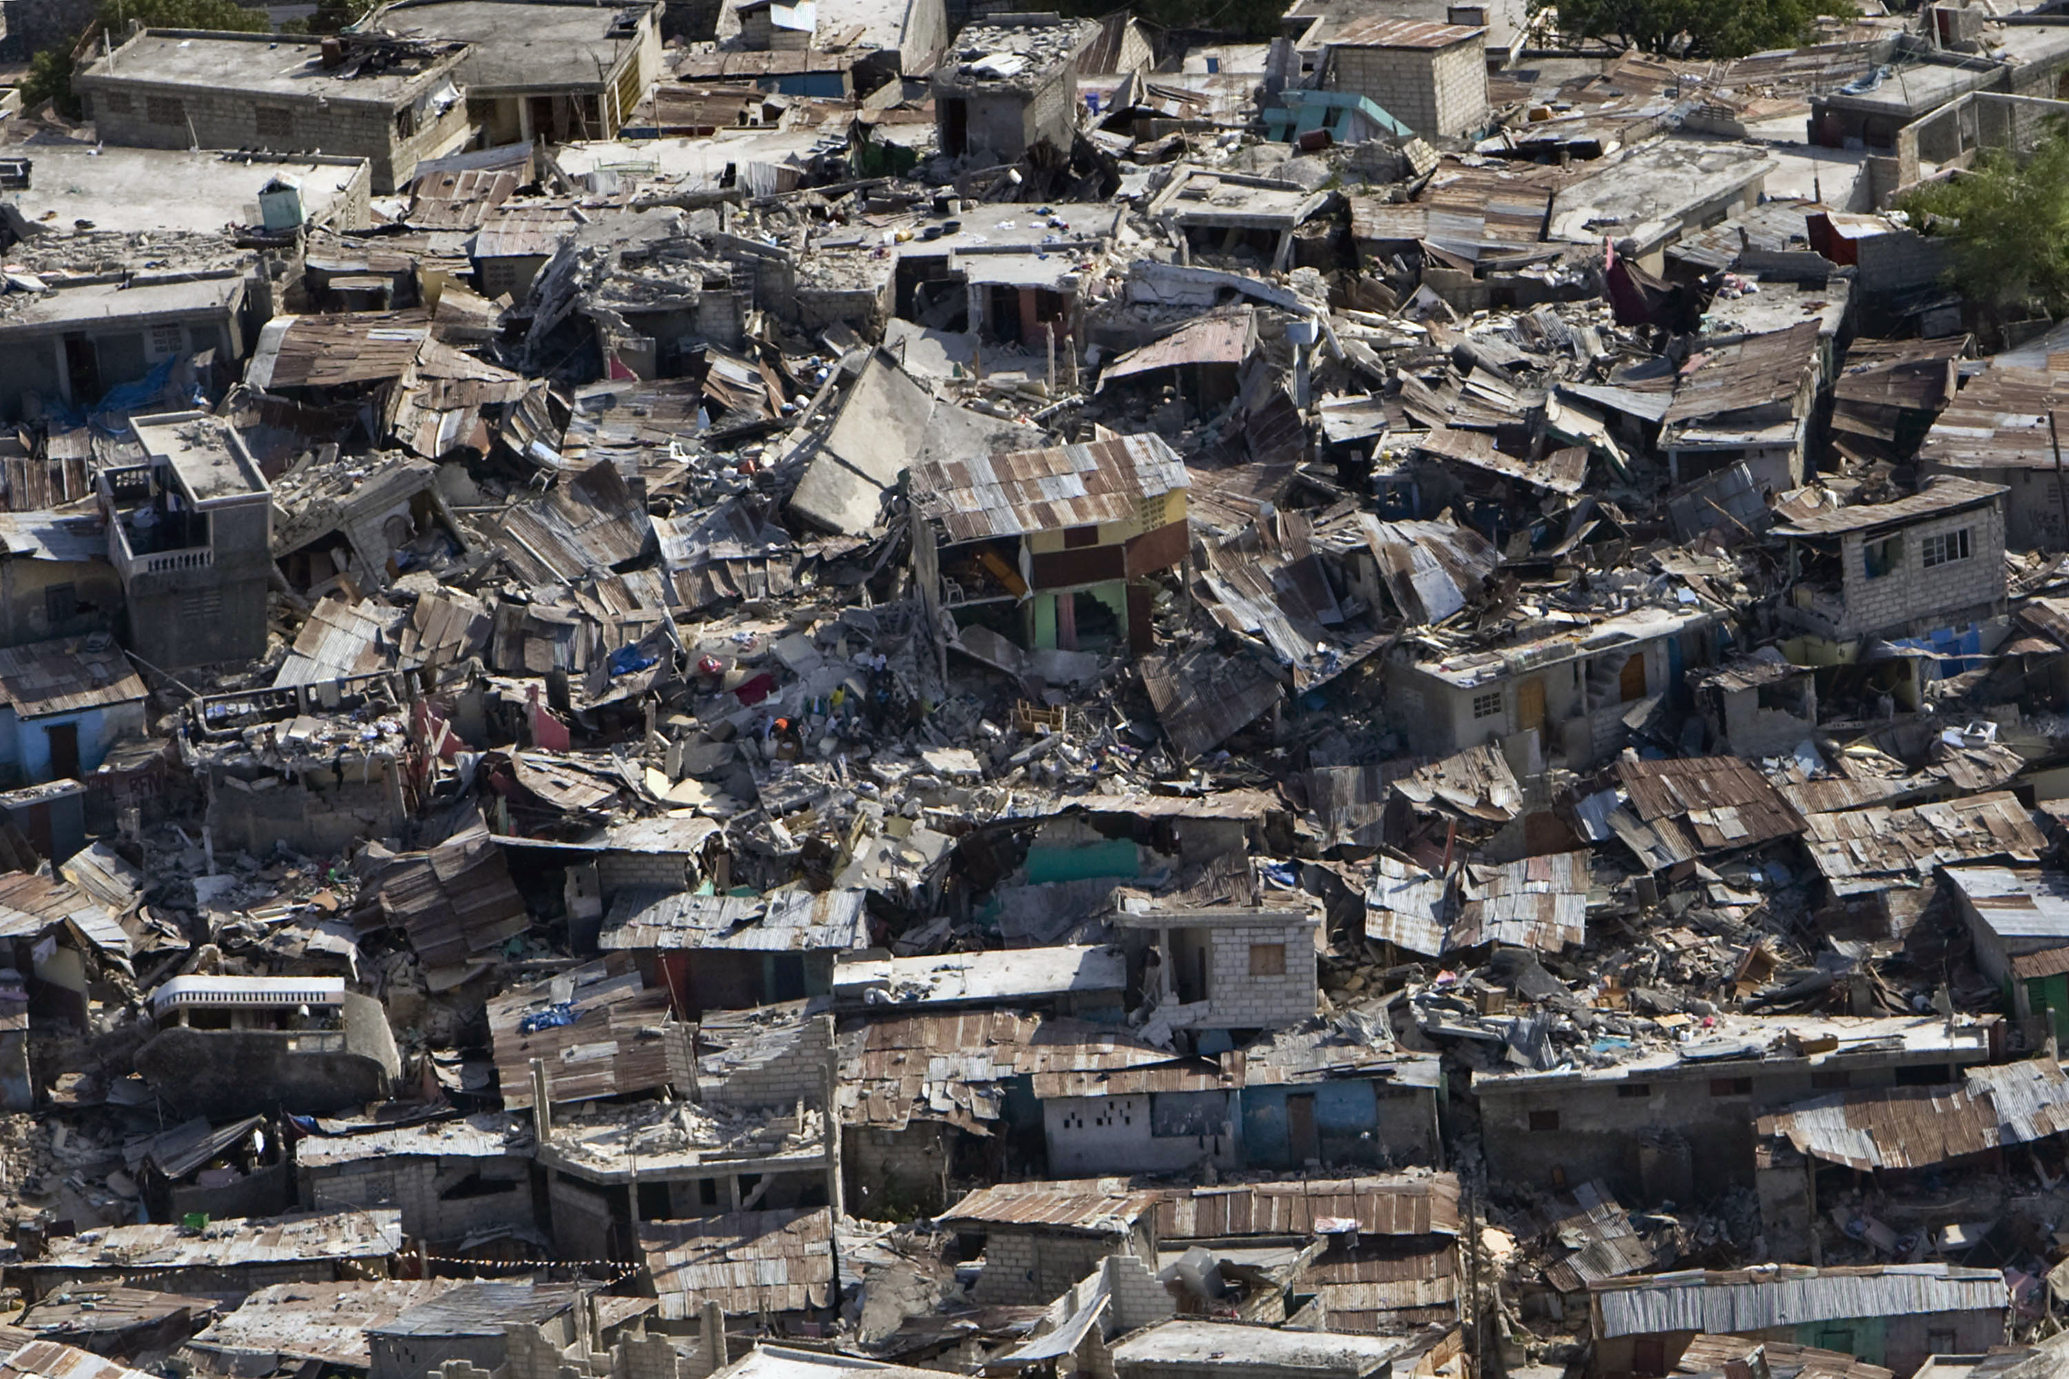

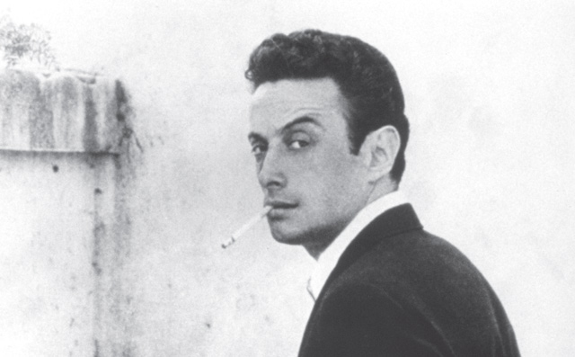
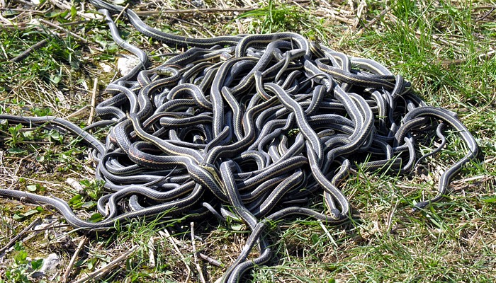


Slide 5


Existential risk
Future of Humanity Institute
Global Challenges Foundation

Slide 6












Global catastrophic risks

Slide 7
Five Key Factors
Reliability of AI Predictions
A single dominant AI or many
How intelligent AI will become
Whether extremely intelligent AI can be controlled
Whether whole brain emulations will come before AI

Slide 8
Five Key Factors
Timeline for development
Order of research progression
How quickly weapons can be assembled
Surveillance capabilities of tools
Whether tools are made outside of human control

Slide 9
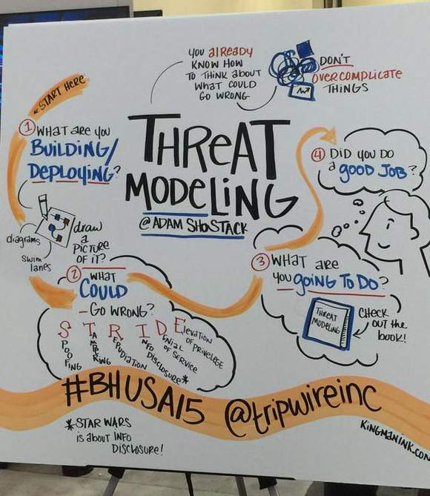
Threat modeling

Slide 10
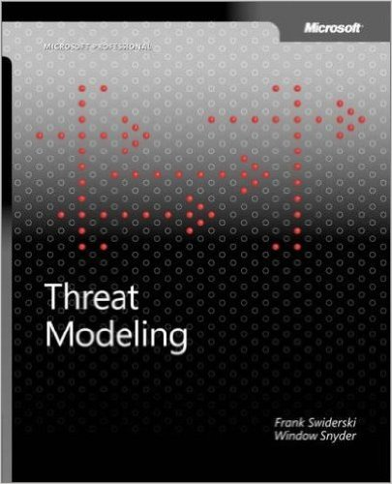

THREAT MODELING – Window Snyder

Slide 11
Threat modeling is a methodology for identifying security vulnerabilities, for identifying the risks of a security vulnerability within that application
Window Snyder

Slide 12





THREAT MODELING – Window Snyder

Slide 13
Threat modeling – Window snyder
Threat Modeling
Adversarial Perspective
Threat Profiling
Creating Models
Testing Derived from Threat Models
Notes:
Adversarial Perspective
Assets of Interest
Entry Points
Exit Points
Threat Profiling
Threat Identification
Threat Trees
Vulnerability Resolution
Creating Models
Features of Models
Testing Derived from Threat Models
Code Reviews
Penetration Testing

Slide 14
Here's a pattern, and if we implement one architectural change we can eliminate all these vulnerabilities.
Window Snyder
The goal, she said, is to remove whole categories of vulnerabilities.

Slide 15


Threat modeling – Adam shostack
Notes:
a technologist, entrepreneur, author and game designer. He's a member of the BlackHat Review Board
helped found the Common Vulnerabilities and Exposures (CVE)
While at Microsoft was the lead designer of the SDL Threat Modeling Tool v3 and created the "Elevation of Privilege" game.
Adam is the author of "Threat Modeling: Designing for Security”

Slide 16

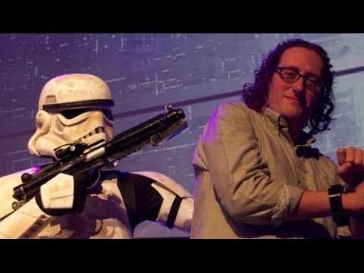
Threat modeling
https://www.youtube.com/watch?v=KLpgaoD8ySM

Slide 17
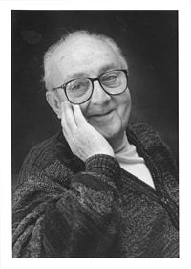
All models are wrong, some models are useful
- George Box

Slide 18
Threat modeling - stride
Spoofing
Tampering
Repudiation
Information Disclosure
Denial of Service
Elevation of Privilege

Slide 19
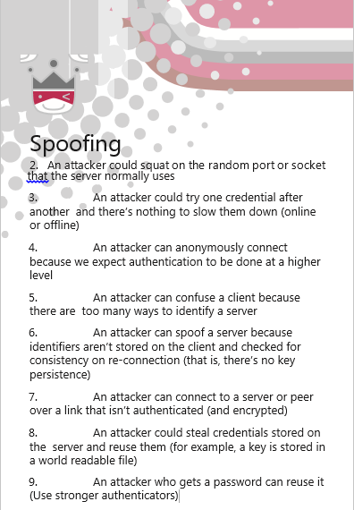
Threat modeling – STRIDE sPOOFING
Impersonating something or someone else
Notes:
“Identity spoofing” is a key risk for applications that have many users but provide a single execution context at the application and database level. In particular, users should not be able to become any other user or assume the attributes of another user.

Slide 20
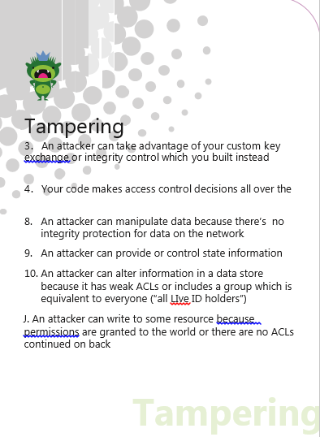
Threat modeling – STRIDE tAMPERING
Modifying data or code
Notes:
users can potentially change data delivered to them, return it, and thereby potentially manipulate client-side validation, GET and POST results, cookies, HTTP headers, and so forth. The application should not send data to the user, such as interest rates or periods, which are obtainable only from within the application itself. The application should also carefully check data received from the user and validate that it is sane and applicable before storing or using it.

Slide 21
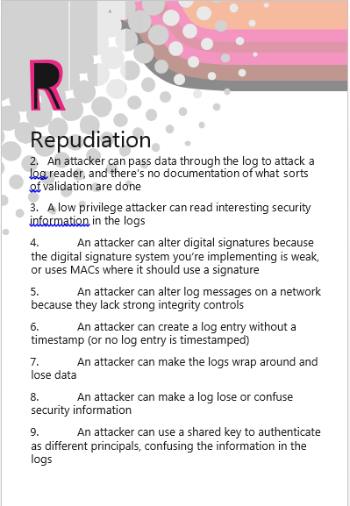
Threat modeling – STRIDE repudiation
Claiming to have not performed an action
Notes:
Users may dispute transactions if there is insufficient auditing or recordkeeping of their activity. For example, if a user says, “But I didn’t transfer any money to this external account!”, and you cannot track his/her activities through the application, then it is extremely likely that the transaction will have to be written off as a loss.
Therefore, consider if the application requires non-repudiation controls, such as web access logs, audit trails at each tier, or the same user context from top to bottom. Preferably, the application should run with the user’s privileges, not more, but this may not be possible with many off-the-shelf application frameworks.

Slide 22
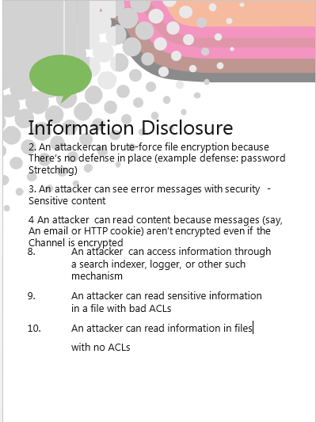
Threat modeling – STRIDE information disclosure
Exposing information to someone not authorized to see it
Notes:
Users are rightfully wary of submitting private details to a system. If it is possible for an attacker to publicly reveal user data at large, whether anonymously or as an authorized user, there will be an immediate loss of confidence and a substantial period of reputation loss. Therefore, applications must include strong controls to prevent user ID tampering and abuse, particularly if they use a single context to run the entire application.
Also, consider if the user’s web browser may leak information. Some web browsers may ignore the no caching directives in HTTP headers or handle them incorrectly. In a corresponding fashion, every secure application has a responsibility to minimize the amount of information stored by the web browser, just in case it leaks or leaves information behind, which can be used by an attacker to learn details about the application, the user, or to potentially become that user.
Finally, in implementing persistent values, keep in mind that the use of hidden fields is insecure by nature. Such storage should not be relied on to secure sensitive information or to provide adequate personal privacy safeguards.

Slide 23
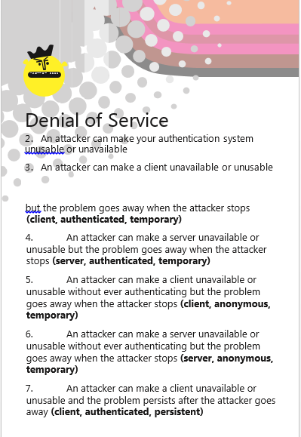
Threat modeling – STRIDE denial of service
Deny or degrade service to users
Notes:
Application designers should be aware that their applications may be subject to a denial of service attack. Therefore, the use of expensive resources such as large files, complex calculations, heavy-duty searches, or long queries should be reserved for authenticated and authorized users, and not available to anonymous users.
For applications that do not have this luxury, every facet of the application should be engineered to perform as little work as possible, to use fast and few database queries, to avoid exposing large files or unique links per user, in order to prevent simple denial of service attacks.

Slide 24
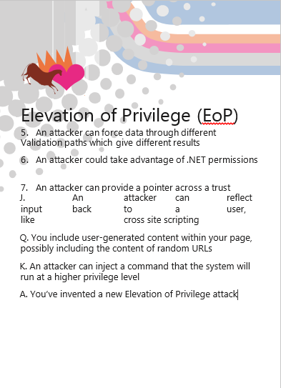
Threat modeling – STRIDE elevation of privilege
Gain capabilities without proper authorization
Notes:
If an application provides distinct user and administrative roles, then it is vital to ensure that the user cannot elevate his/her role to a higher privilege one. In particular, simply not displaying privileged role links is insufficient. Instead, all actions should be gated through an authorization matrix, to ensure that only the permitted roles can access privileged functionality.

Slide 25
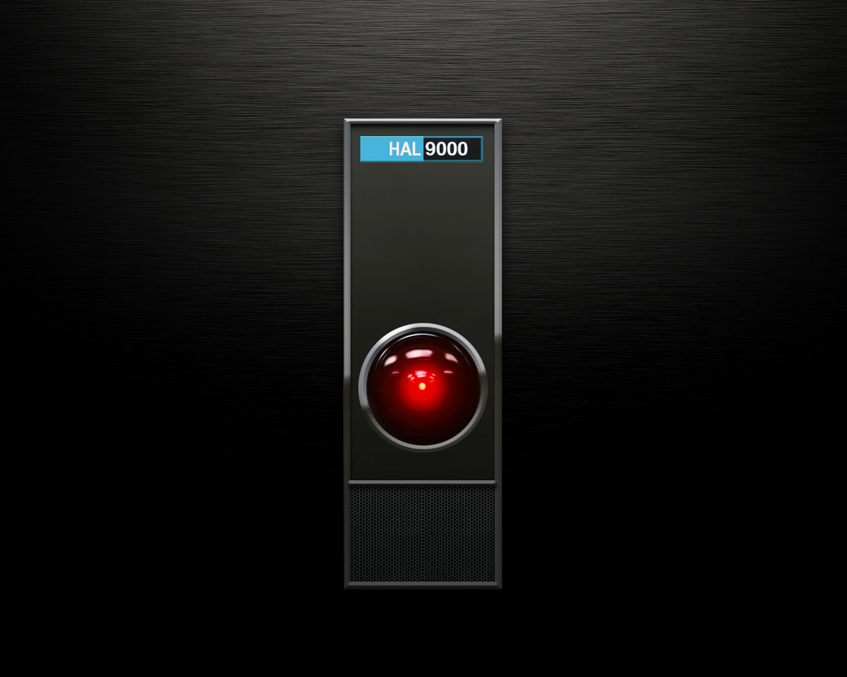
Artificial intelligence

Slide 26
Artificial intelligence
Overview
Ray Kurzweil
Eliezer Yudkowsky
Nick Bostrom

Slide 27

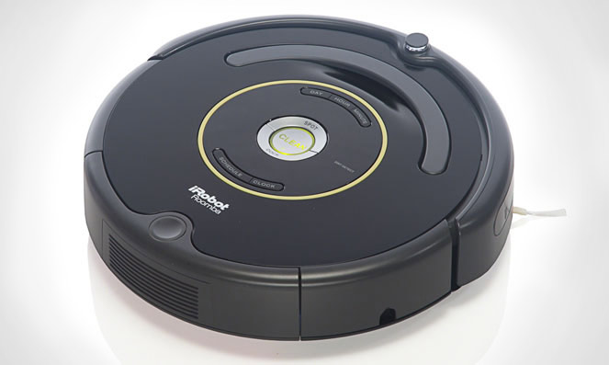

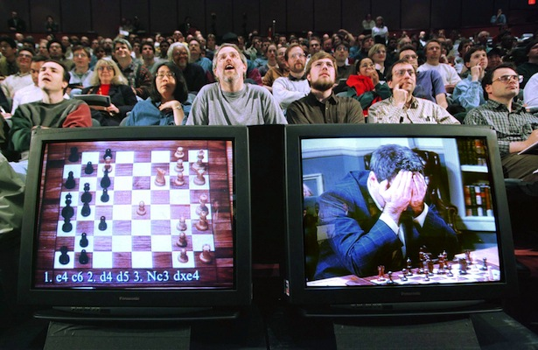
Artificial intelligence – Weak ai

Slide 28

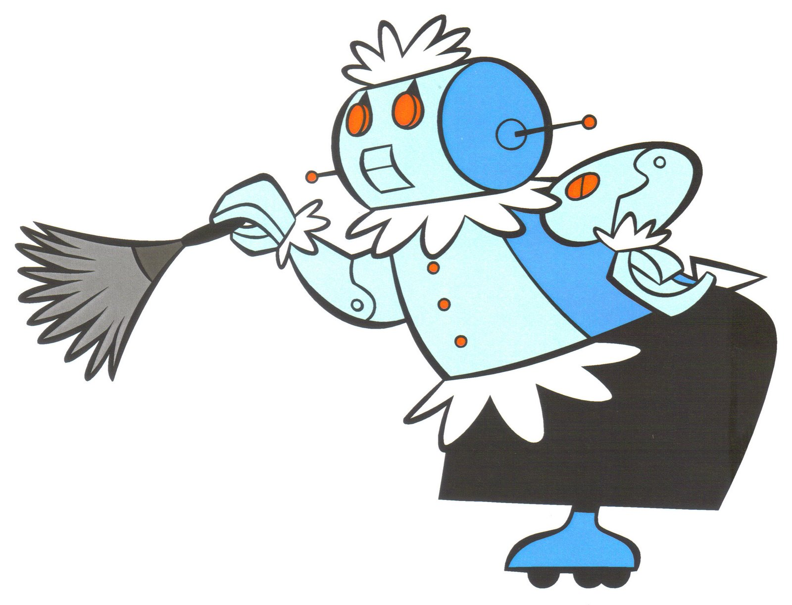
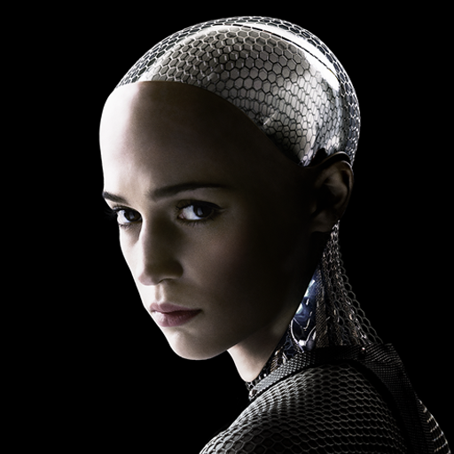
Artificial intelligence – Strong ai (Agi)

Slide 29
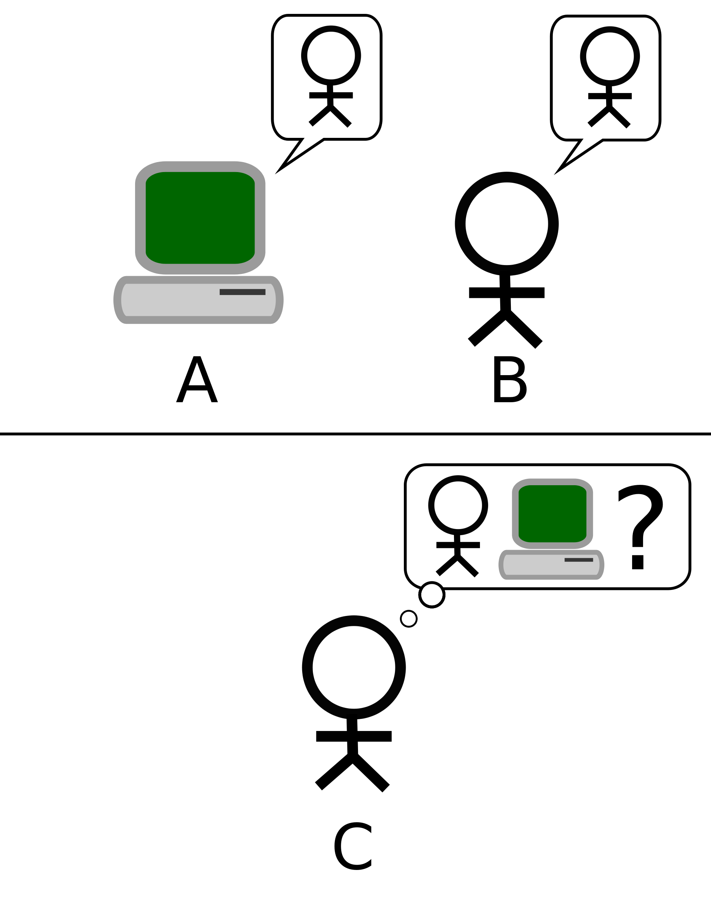


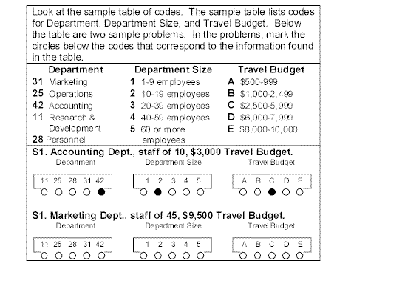
Artificial intelligence – Strong ai (Agi)

Slide 30
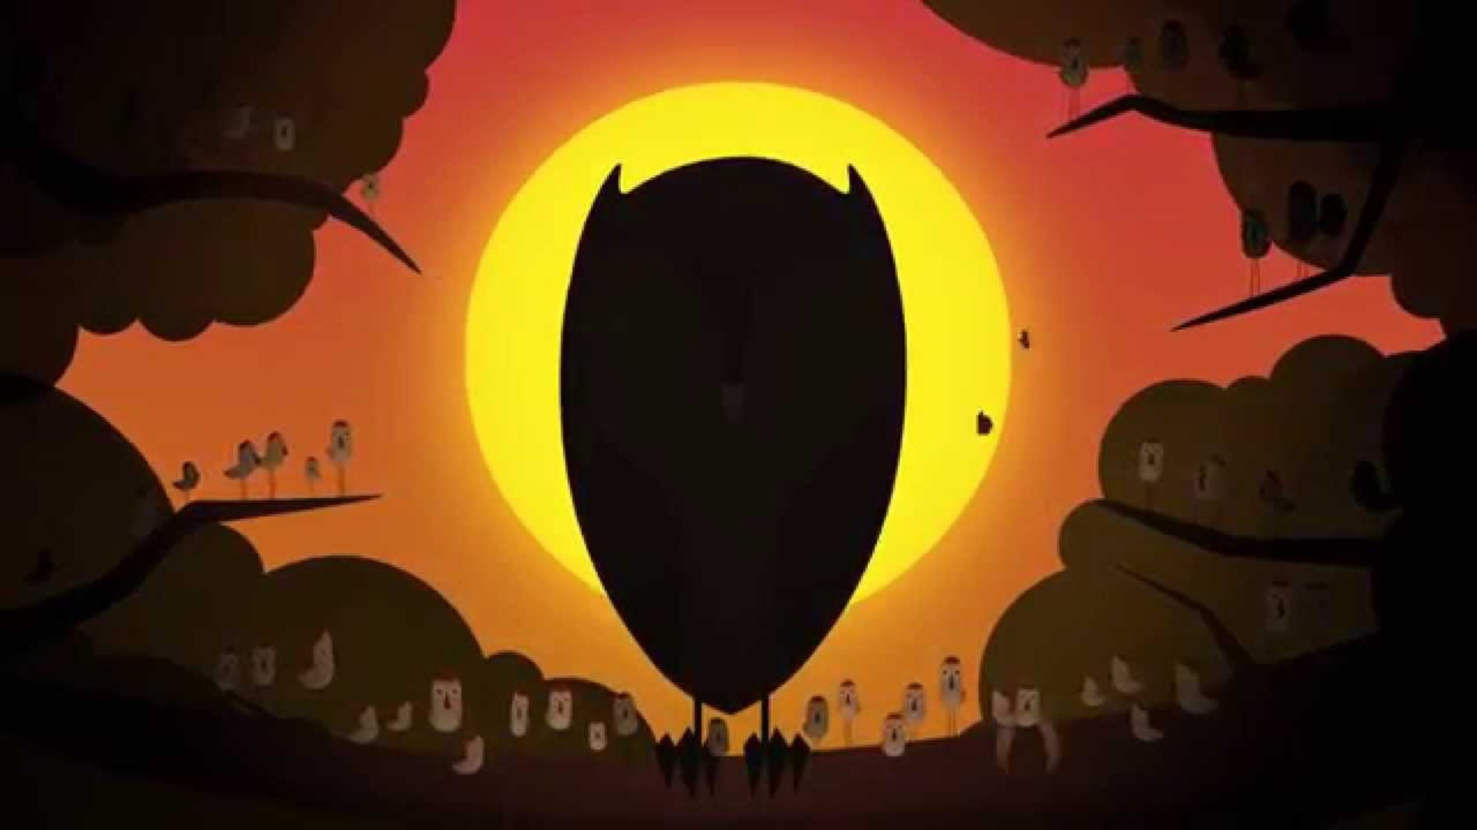
Artificial intelligence – superintelligence

Slide 31
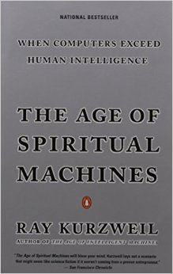
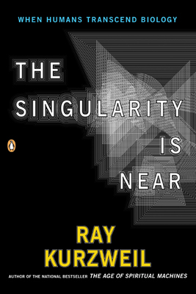
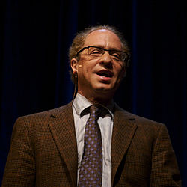
Artificial intelligence – Ray kurzweil
Notes:
is an American author, computer scientist, inventor and futurist. Aside from futurology, he is involved in fields such as optical character recognition (OCR), text-to-speech synthesis, speech recognition technology, and electronic keyboard instruments. He has written books on health, artificial intelligence (AI), transhumanism, the technological singularity, and futurism. Kurzweil is a public advocate for the futurist and transhumanist movements, and gives public talks to share his optimistic outlook on life extension technologies and the future of nanotechnology, robotics, and biotechnology.

Slide 32
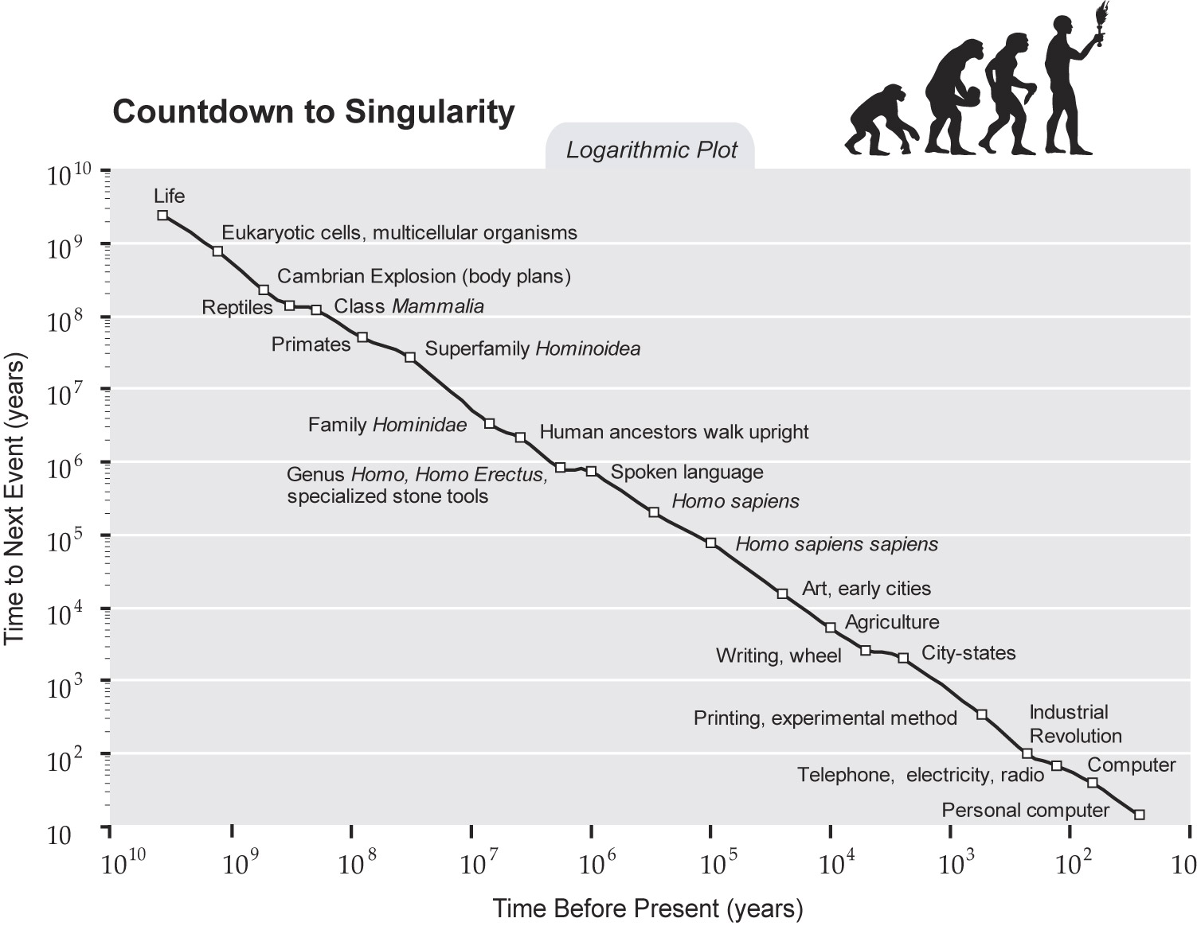
Ray Kurzweil - singularity
Notes:
Kurzweil touches on the history of the Singularity concept, tracing it back to John von Neumann in the 1950s and I. J. Good in the 1960s. He compares his Singularity to that of a mathematical or astrophysical singularity. While his ideas of a Singularity is not actually infinite, he says it looks that way from any limited perspective
During the Singularity Kurzweil predicts "human life will be irreversibly transformed"[29] and humans will transcend the "limitations of our biological bodies and brain".[30] He looks beyond the Singularity to say that "the intelligence that will emerge will continue to represent the human civilization", he feels that "future machines will be human, even if they are not biological".[31]
Kurzweil claims once nonbiological intelligence predominates the nature of human life will be radically altered:[32] there will be radical changes in how humans learn, work, play, and wage war.

Slide 33
law of accelerating returns
Paradigm Shift Enables Exponential Growth To Continue
Process Derived From Evolutionary Process
More Cost Effective
More Resources Deployed
Returns
Speed
Power
Cost Effective
Positive Feedback Loop
Evolutionary
Process
Returns
Speed
Power
Cost Effective
Method
Becomes More Capable
Order Increases
How Well Purpose Fits

Slide 34
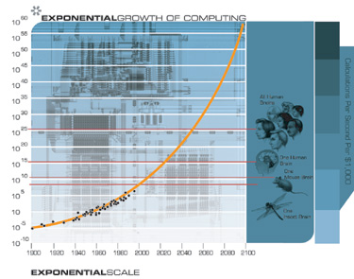
Ray Kurzweil – law of accelerating returns
Notes:
The law of accelerating returns is the idea that technology doesn’t move at a linear pace. That is, human technological progress becomes faster and faster because each period of time is more advanced than the one before it.

Slide 35
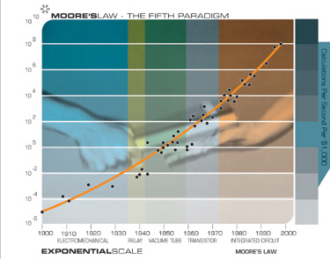
Ray Kurzweil –Moore’s law
Notes:
Moore’s Law narrowly refers to the number of transistors on an integrated circuit of fixed size, and sometimes has been expressed even more narrowly in terms of transistor feature size. But rather than feature size (which is only one contributing factor), or even number of transistors, I think the most appropriate measure to track is computational speed per unit cost. This takes into account many levels of “cleverness” (i.e., innovation, which is to say, technological evolution). In addition to all of the innovation in integrated circuits, there are multiple layers of innovation in computer design, e.g., pipelining, parallel processing, instruction look-ahead, instruction and memory caching, and many others.
From the above chart, we see that the exponential growth of computing didn’t start with integrated circuits (around 1958), or even transistors (around 1947), but goes back to the electromechanical calculators used in the 1890 and 1900 U.S. Census. This chart spans at least five distinct paradigms of computing, of which Moore’s Law pertains to only the latest one.

Slide 36


Artificial intelligence – Eliezer Yudkowsky
Notes:
Yudkowsky's interests focus on Artificial Intelligence theory for self-awareness, self-modification, and recursive self-improvement, and on artificial-intelligence architectures and decision theories for stable motivational structures (Friendly AI and Coherent Extrapolated Volition in particular).[6]:420 Yudkowsky's most recent work is on decision theory for problems of self-modification and Newcomblike problems.
He co-founded the nonprofit Machine Intelligence Research Institute (formerly the Singularity Institute for Artificial Intelligence) in 2000 and continues to be employed there as a full-time Research Fellow.

Slide 37
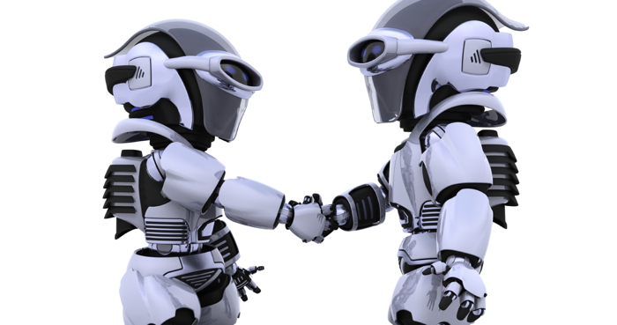
Artificial intelligence – Eliezer Yudkowsky
Notes:
2008 Paper “Artificial Intelligence as a Positive and Negative Factor in Global Risk”

Slide 38
Artificial intelligence – Coherent extrapolated volition (CEV)
CEV
Knew More
Thought Faster
Were More The People We Wish We Were
Had Grown Up Farther Together

Slide 39
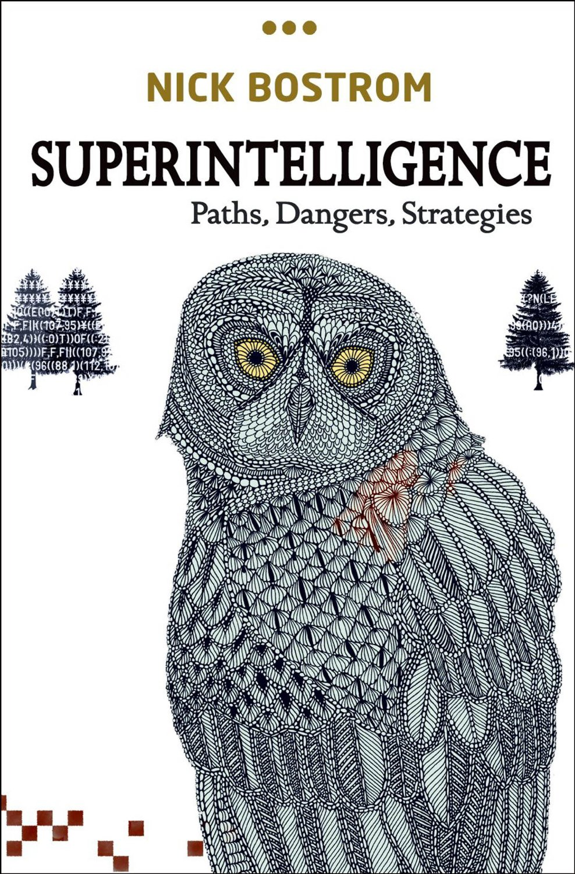
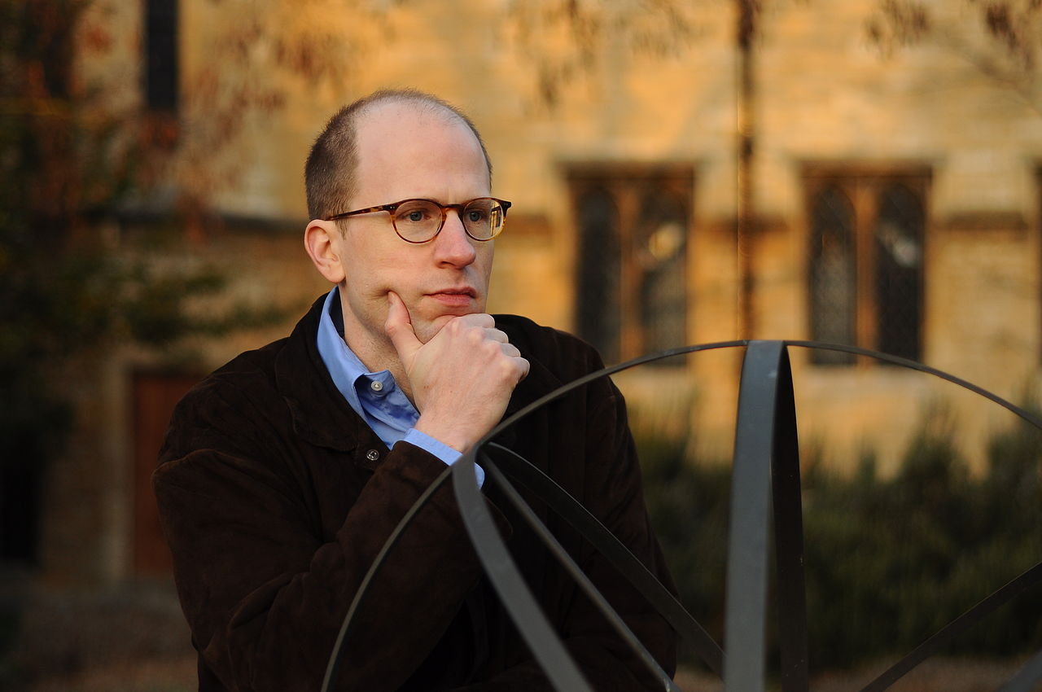
Artificial intelligence – Nick bostrom
Notes:
a Swedish philosopher at the University of Oxford known for his work on existential risk, the anthropic principle, human enhancement ethics, superintelligence risks, the reversal test, and consequentialism. He holds a PhD from the London School of Economics (2000). In 2011, he founded the Oxford Martin Programme on the Impacts of Future Technology,[2] and he is currently the founding director of the Future of Humanity Institute[3] at Oxford University.

Slide 40




Nick bostrom – existential risk classification
Notes:
Bangs – Earth-originating intelligent life goes extinct in relatively sudden disaster resulting from either an accident or a deliberate act of destruction.
Crunches – The potential of humankind to develop into posthumanity is permanently thwarted although human life continues in some form.
Shrieks – Some form of posthumanity is attained but it is an extremely narrow band of what is possible and desirable.
Whimpers – A posthuman civilization arises but evolves in a direction that leads gradually but irrevocably to either the complete disappearance of the things we value or to a state where those things are realized to only a minuscule degree of what could have been achieved.

Slide 41
Nick bostrom – existential risk classification
Bangs
Misuse of Nanotechnology
Shrieks
Whimpers
Killed By Aliens
Crunches
Resource Depletion
Potential Eroded By Evolution
Transcending Upload Takeover
Nuclear Holocaust
Simulation
Genetic Engineering
Nanotechnology Accident
Physics Disaster
Naturally Occurring Disease
Asteroid / Comet
Global Warming
Misguided World Government
Technological Arrest
Flawed ASI
Oppressive Regime

Slide 42
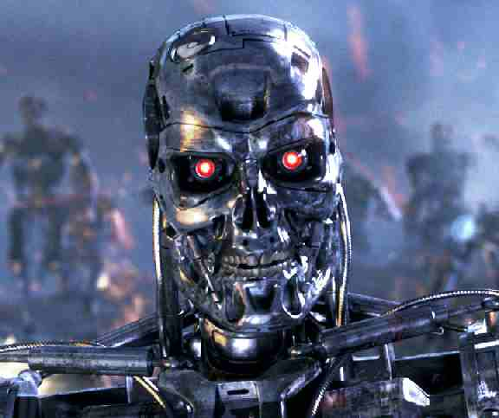
Nick bostrom - recalcitrance
Notes:
‘Recalcitrance’ here refers to how amenable a system might be to improvements, a value which varies enormously for different pathways to superintelligence
Recalcitrance is defined as the inverse of the rate of increase to intelligence per time per unit of effort put into increasing that intelligence. It is meant to capture how hard it is to make an intelligent system smarter, and in particular how hard it is for an intelligent system to make itself smarter.
Bostrom’s argument is that if an intelligent system’s recalcitrance is constant or lower, then it is possible for the system to undergo an “intelligence explosion” and take over the world.

Slide 43
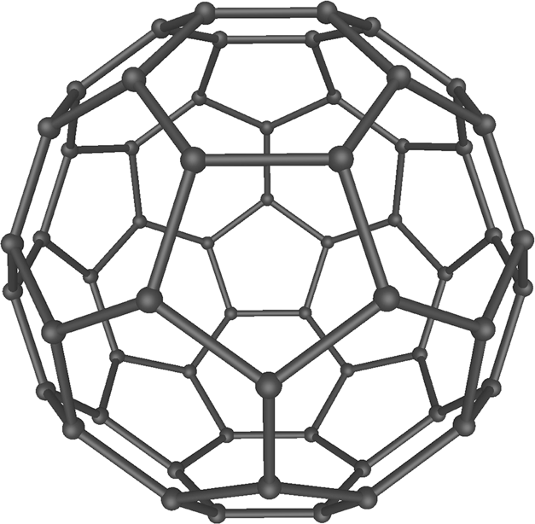
nanotechnology

Slide 44
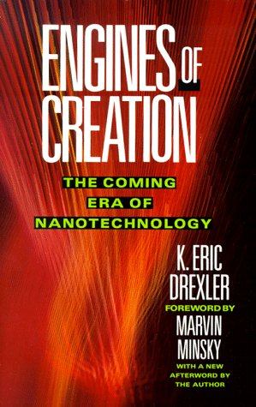

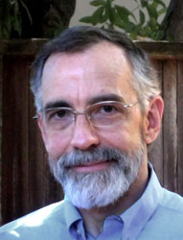
Nanotechnology – k. eric drexler
Notes:
American engineer best known for popularizing the potential of molecular nanotechnology
Pioneer of nanotechnology
Building components molecule by molecule
Nanomachines could be made in very small places

Slide 45

K. Eric Drexler ENGINES OF CREATION
Notes:
Molecular Engineering:
An approach to the development of general capabilities for molecular manipulation

Slide 46

K. Eric Drexler atomically precise manufacturing
Notes:
Throughout history, states have developed technologies to extend their military power, and states will no doubt play a dominant role in developing replicators and AI systems. States could use replicating assemblers to build arsenals of advanced weapons, swiftly, easily, and in vast quantity. States could use special replicators directly to wage a sort of germ warfare - one made vastly more practical by programmable, computer-controlled "germs." Depending on their skills, AI systems could serve as weapon designers, strategists, or fighters. Military funds already support research in both molecular technology and artificial intelligence.
States could use assemblers or advanced AI systems to achieve sudden, destabilizing breakthroughs. I earlier discussed reasons for expecting that the advent of replicating assemblers will bring relatively sudden changes: Able to replicate swiftly, they could become abundant in a matter of days. Able to make almost anything, they could be programmed to duplicate existing weapons, but made from superior materials. Able to work with standard, well-understood components (atoms) they could suddenly build things designed in anticipation of the assembler breakthrough. These results of design-ahead could include programmable germs and other nasty novelties. For all these reasons, a state that makes the assembler breakthrough could rapidly create a decisive military force - if not literally overnight, then at least with unprecedented speed.

Slide 47

K. Eric Drexler Threats From machines
Notes:
Among the cognoscenti of nanotechnology, this threat has become known as the "gray goo problem." Though masses of uncontrolled replicators need not be gray or gooey, the term "gray goo" emphasizes that replicators able to obliterate life might be less inspiring than a single species of crabgrass. They might be "superior" in an evolutionary sense, but this need not make them valuable. We have evolved to love a world rich in living things, ideas, and diversity, so there is no reason to value gray goo merely because it could spread. Indeed, if we prevent it we will thereby prove our evolutionary superiority.
The gray goo threat makes one thing perfectly clear: we cannot afford certain kinds of accidents with replicating assemblers.

Slide 48
K. Eric Drexler Threats From assembler breakthrough
X
Notes:
Among the cognoscenti of nanotechnology, this threat has become known as the "gray goo problem." Though masses of uncontrolled replicators need not be gray or gooey, the term "gray goo" emphasizes that replicators able to obliterate life might be less inspiring than a single species of crabgrass. They might be "superior" in an evolutionary sense, but this need not make them valuable. We have evolved to love a world rich in living things, ideas, and diversity, so there is no reason to value gray goo merely because it could spread. Indeed, if we prevent it we will thereby prove our evolutionary superiority.
The gray goo threat makes one thing perfectly clear: we cannot afford certain kinds of accidents with replicating assemblers.

Slide 49
K. Eric Drexler probability of success
Success is probable based on our experiences
Replicators are physical systems
Biological life has been defending against invasive replicators since creation
AI can become a Nanomanager
AI – SW
Nanotechnology - HW
Notes:
With our present uncertainties, we cannot yet describe either threats or shields with any accuracy. Does this mean we can't have any confidence that effective shields are possible? Apparently we can; there is a difference, after all, between knowing that something is possible and knowing how to do it. And in this case, the world holds examples of analogous successes. There is nothing fundamentally novel about defending against invading replicators; life has been doing it for ages. Replicating assemblers, though unusually potent, will be physical systems not unlike those we already know. Experience suggests that they can be controlled. Viruses are molecular machines that invade cells; cells use molecular machines (such as restriction enzymes and antibodies) to defend against them. Bacteria are cells that invade organisms; organisms use cells (such as white blood cells) to defend against them. Similarly, societies use police to defend against criminals and armies to defend against invaders. On a less physical level, minds use meme systems such as the scientific method to defend against nonsense, and societies use institutions such as courts to defend against the power of other institutions. The biological examples in the last paragraph show that even after a billion-year arms race, molecular machines have maintained successful defenses against molecular replicators. Failures have been common too, but the successes do indicate that defense is possible. These successes suggest that we can indeed use nanomachines to defend against nanomachines. Though assemblers will bring many advances, there seems no reason why they should permanently tip the balance against defense. The examples given above - some involving viruses, some involving institutions - are diverse enough to suggest that successful defense rests on general principles. One might ask, Why do all these defenses succeed? But turn the question around: Why should they fail? Each conflict pits similar systems against each other, giving the attacker no obvious advantage. In each conflict, moreover, the attacker faces a defense that is well established. The defenders fight on home ground, giving them advantages such as prepared positions, detailed local knowledge, stockpiled resources, and abundant allies - when the immune system recognizes a germ, it can mobilize the resources of an entire body. All these advantages are general and basic, having little to do with the details of a technology. We can give our active shields the same advantages over dangerous replicators. And they need not sit idle while dangerous weapons are amassed, any more than the immune system sits idle while bacteria multiply. It would be hard to predict the outcome of an open-ended arms race between powers equipped with replicating assemblers. But before this situation can arise, the leading force seems likely to acquire a temporary but overwhelming military advantage. If the outcome of an arms race is in doubt, then the leading force will likely use its strength to ensure that no opponents are allowed to catch up. If it does so, then active shields will not have to withstand attacks backed by the resources of half a continent or half a solar system; they will instead be like a police force or an immune system, facing attacks backed only by whatever resources can be gathered in secret within the protected territory. In each case of successful defense that I cited above, the attackers and the shields have developed through broadly similar processes. The immune system, shaped by genetic evolution, meets threats also shaped by genetic evolution. Armies, shaped by human minds, also meet similar threats. Likewise, both active shields and dangerous replicators will be shaped by memetic evolution. But if the leading force can develop automated engineering systems that work a millionfold faster than human engineers, and if it can use them for a single year, then it can build active shields based on a million years' worth of engineering advance. With such systems we may be able to explore the limits of the possible well enough to build a reliable shield against all physically possible threats. Even without our knowing the details of the threats and the shields, there seems reason to believe that shields are possible. And the examples of memes controlling memes and of institutions controlling institutions also suggest that AI systems can control AI systems. In building active shields, we will be able to use the power of replicators and AI systems to multiply the traditional advantages of the defending force: we can give it overwhelming strength through abundant, replicator-built hardware with designs based on the equivalent of a million-year lead in technology. We can build active shields having strength and reliability that will put past systems to shame. Nanotechnology and artificial intelligence could bring the ultimate tools of destruction, but they are not inherently destructive. With care, we can use them to build the ultimate tools of peace.

Slide 50

THREAT MODELING EXISTENTIAL RISK: Nick bostrom - Superintelligence
https://github.com/hello7s/Existential-Threat-Models
Notes:
‘Recalcitrance’ here refers to how amenable a system might be to improvements, a value which varies enormously for different pathways to superintelligence
Recalcitrance is defined as the inverse of the rate of increase to intelligence per time per unit of effort put into increasing that intelligence. It is meant to capture how hard it is to make an intelligent system smarter, and in particular how hard it is for an intelligent system to make itself smarter.
Bostrom’s argument is that if an intelligent system’s recalcitrance is constant or lower, then it is possible for the system to undergo an “intelligence explosion” and take over the world.

Slide 51

Threat modeling existential risk – closing thoughts
Notes:
First described by Bostrom (2003), a paperclip maximizer is an artificial general intelligence (AGI) whose goal is to maximize the number of paperclips in its collection. If it has been constructed with a roughly human level of general intelligence, the AGI might collect paperclips, earn money to buy paperclips, or begin to manufacture paperclips.
Most importantly, however, it would undergo an intelligence explosion: It would work to improve its own intelligence, where "intelligence" is understood in the sense of optimization power, the ability to maximize a reward/utility function—in this case, the number of paperclips. The AGI would improve its intelligence, not because it values more intelligence in its own right, but because more intelligence would help it achieve its goal of accumulating paperclips. Having increased its intelligence, it would produce more paperclips, and also use its enhanced abilities to further self-improve. Continuing this process, it would undergo an intelligence explosion and reach far-above-human levels.
It would innovate better and better techniques to maximize the number of paperclips. At some point, it might convert most of the matter in the solar system into paperclips.
This may seem more like super-stupidity than super-intelligence. For humans, it would indeed be stupidity, as it would constitute failure to fulfill many of our important terminal values, such as life, love, and variety. The AGI won't revise or otherwise change its goals, since changing its goals would result in fewer paperclips being made in the future, and that opposes its current goal. It has one simple goal of maximizing the number of paperclips; human life, learning, joy, and so on are not specified as goals. An AGI is simply an optimization process—a goal-seeker, a utility-function-maximizer. Its values can be completely alien to ours. If its utility function is to maximize paperclips, then it will do exactly that.
A paperclipping scenario is also possible without an intelligence explosion. If society keeps getting increasingly automated and AI-dominated, then the first borderline AGI might manage to take over the rest using some relatively narrow-domain trick that doesn't require very high general intelligence.

Slide 52
references
Frank Swiderski and Window Snyder. Threat Modeling. Microsoft Press, 2004.
http://www.cnet.com/news/at-mozilla-blowing-the-lid-off-security-practices/
Threat Modeling Star Wars - https://www.icsi.berkeley.edu/icsi/events/2014/03/shostack-threat-model
www.youtube.com/watch?v=KLpgaoD8ySM
Luke Mueller - Robust Cooperation: A Case Study in Friendly AI Research:
https://intelligence.org/2014/02/01/robust-cooperation-a-case-study-in-friendly-ai-research/

Slide 53
Image credits
Galactic Collision. Digital image. It's the end of the Galaxy as We Know It. UC San Diego, n.d. Web 15 Dec 2012 <http://www.sdsc.edu/pub/envision/v16.1/hernquist.html
Adam Shostack – Threat Modeling Star Wars https://www.youtube.com/watch?v=KLpgaoD8ySM http://i.ytimg.com/vi/KLpgaoD8ySM/hqdefault.jpg
Artificial Intelligence – Superintelligence http://www.future-trends.co/1211894039.html
Recalcitrance - http://www.dailymail.co.uk/sciencetech/article-3143275/Artificial-intelligence-real-threat-robots-wipe-humanity-ACCIDENT-claims-expert.html
Engines of Power - https://neurophilosophy.wordpress.com/2006/08/22/614/

